Slide 1

Wedding event organization
Presented by
S.Sathya Priya
M.Jeeva A.Mary Suganthi A.Christina Mary

Slide 2

CONTENTS
1.Abstract.
2.Using platform.
3.Screenshot.
4.Existing system.
5.Propost system.
6.conclusion.

Slide 3
ABSTRACT
The wedding event organization is a web based application.
It is having to the more than advantages of the event organization. It’s saving your time.
The event organization project is designed to be user-friendly and efficient.
Stay on schedule keep costs and resources to budget.

Slide 4
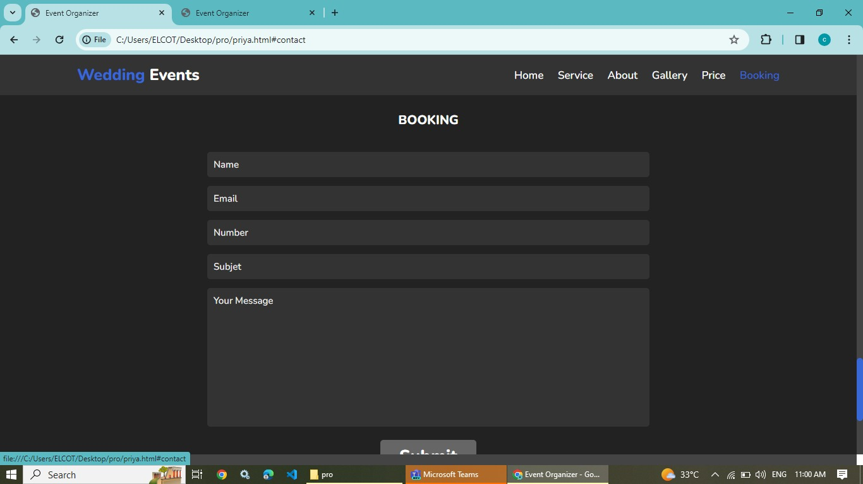

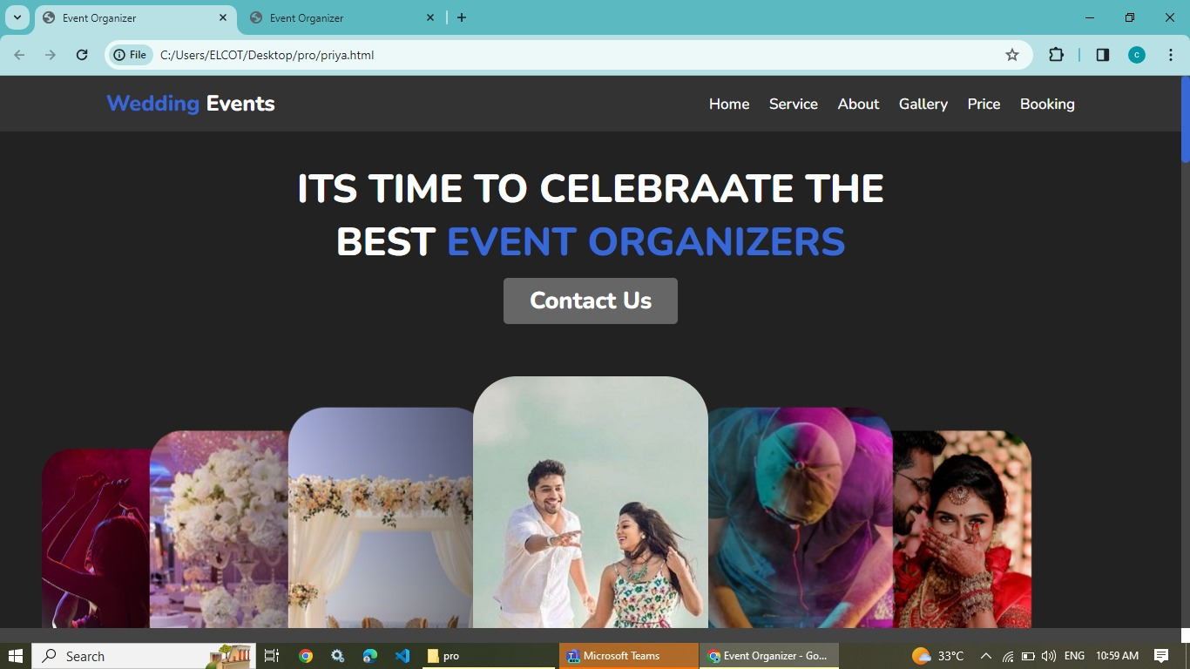
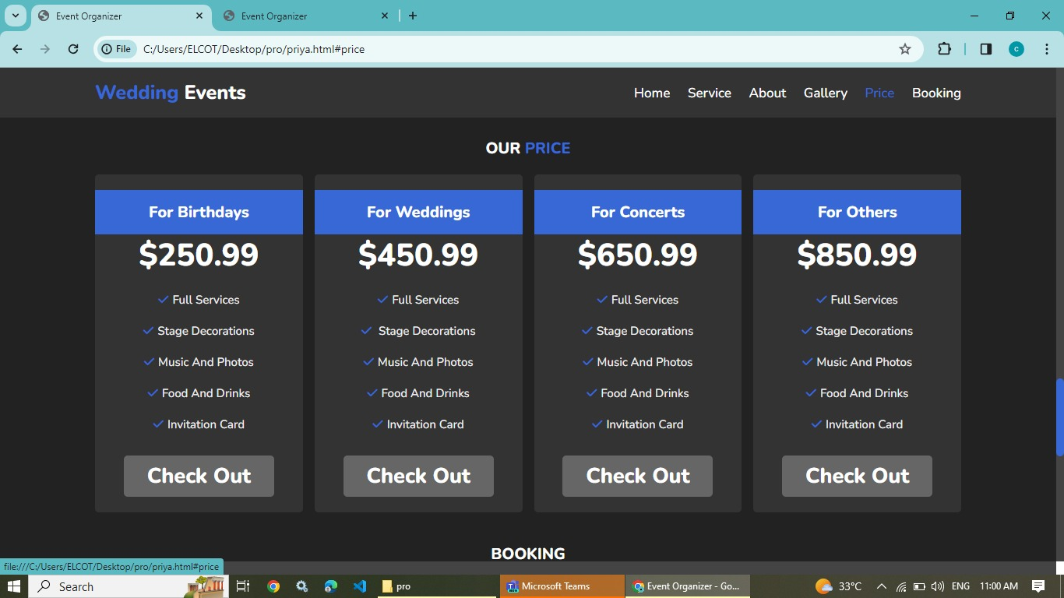
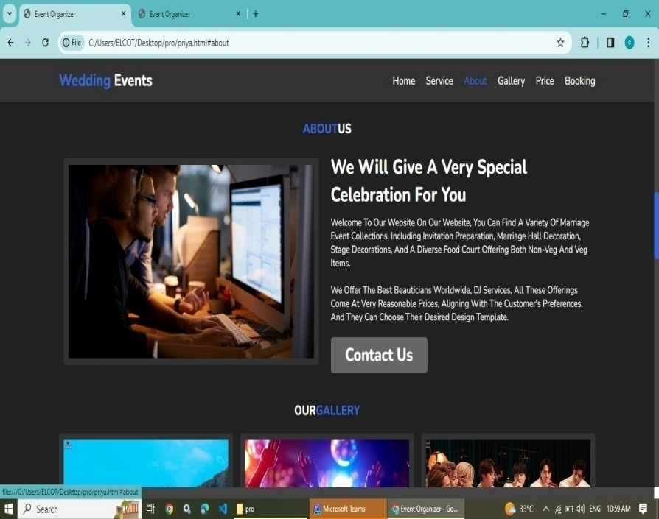
Screenshot

Slide 5
3.Screenshot.
HTML
CSS
JAVASCRIPT
PHP

Slide 6
HTML
We are using in the HTML plat from in this web application.
it is hyper text markup language. we would have heard of the advantages of HTML describing it to be platform-independent(works on all operating system like windows, Linux, etc),easy to learn, no setup(simply saving the document with the extension.

Slide 7
CSS
CSS is cascading style sheet is a style sheet
language used for specifying the presentation and styling of a document written in a markup language such as HTML or XML.
with CSS, you can control the colour, font, the size of text, the spacing between elements , how elements
Are positioned and laid out .
what background images or background are to be used, different device and screen ,and much more!

Slide 8
JAVASCRIPT
JavaScript is a scripting language .there are mainly two advantages of JavaScript function. code resusability. We can a function several time so it save coding.
There mainly two advantage of javaScript function. Code reusability:we can call a functin several times so it save coding.

Slide 9
PHP
The full form PHP is Hypertext preprocessor. it was abbreviated previously as personal home pages.
It is a programming language widely used to build web application or website.
We are using in the PHP plat form to connecting in the database of the backend.

Slide 10
EXISTING SYSTEM
in the existing system the exams are done only manually but in proposed system we have to computerize the exams using this web applications.
Lack of security of data…
More power…

Slide 11
Proposed system
Security of the data.
Ensure data accuracy.
Proper control of higher official.
Data collection
Automate tasks.
Efficient planning and organization.
Minimize manual data entry.

Slide 12
CONCLUSION
Here we have come to the end of this project on the topic….It was wonderful and learning experience for we all while working on this project.

Slide 13


